Slide 1



Hyperledger Fabric
HyperLedger Hands On Workshop
Grant Steinfeld
IBM Developer Advocate
New York City
Presentation slides and more info at
https://bit.ly/2J7DAN2
Blockchain Explored Series
IBM Blockchain Platform Explored
Architectures Explored
Fabric Explored
VS Code Extension demo
v2.0.0 March 2019
Notes:
This is a technical dive into blockchain architectures. Presentations in the “Explored” series are:
IBM Blockchain Platform Explored: How the IBM Blockchain Platform works.
Architectures Explored: Good blockchain architectures
Fabric Explored: Technical dive on Hyperledger Fabric
Code IBP extension
Technical demos:
Coffee BlockBean - Fair Trade
Simple tic-tac-toe - follow along ( time permitting _ Code IBP extension
Wrap
Q&A

Slide 2
Agenda
Introduction
Blockchain Basics
Hyperledger Fabric Blockchain
Use cases
How to Build your own – VS code
Wrap up
Q&A

Slide 3
Introduction
Developer Advocate at IBM, specializing in Blockchain, Java and NodeJS
Senior software engineer 25 years
Distrubuted systems - Trading systems and decision analysis
Blockchain interest 2 years – life logging and personal music playlist ledgers
Blog: https://medium.com/@grantsteinfeld
GitHub: https://github.com/grant-steinfeld LinkedIn: https://linkedin.com/in/grant-steinfeld www: https://GrantSteinfeld.com
Notes:
Storytelling, documentation, ecosystems

Slide 4
Blockchain 101
Distributed ledger technology underlying bitcoin and other cryptocurrencies.
Mechanism for updating truth states in distributed network computing producing consensus trust
Serving as a new form of general computational substrate.
Melanie Swan
Notes:
Satoshi Nakamoto – Bitcoin whitepaper outlined the mechanism of the blockchain to allow for digital currency double spending problem.
Ref: Software Engineering Daily -→ Melanie Swan

Slide 5
Birth of Hyperledger Fabric ( aka Fabric )
Develop blockchain applications
For the enterprise
Key characteristics:
Permissioned
Privacy
Highly modular
Pluggable consensus, ledger, CA …
Smart contract – general purpose language
No `mining` or crypto-currency required for consensus
Notes:
Along with others, IBM identified that core aspects of Blockchains could be used for purposes that Crypto
Highlight key points – biz not fuxn in public
Mismatch biz network vs what other bch networks provided
Biz not func in public –partnerships and private relationships
Higher perf.
15 tx/sec bitound 3000 tx/sec – 25k tx/sec
Performance .5 million tx /min on Mainframe Hardware
Fab written in Go – pluggable api – Java JS or your own
Embed Ethereum VM – solidity good too!
No mining - gas biz make money by trading goods
5 Bch projects / framework – Fabric most popular

Slide 6
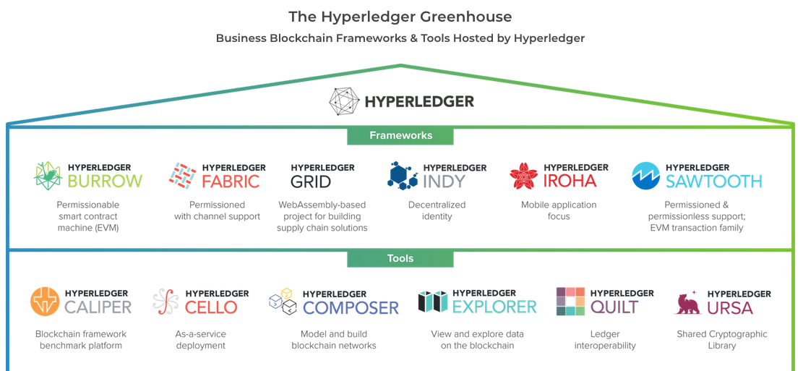
Linux Foundation & Hyperledger Foundation
March 2019
https://www.hyperledger.org/
Notes:
2017
IBM becomes a founding member of Linux Foundation Hyperledger; donates code and intellectual property
2019
IBM HL Fabric v1.4.x LTS
Tool Composer has been deprecated !!
Other interesting Bch platforms :
Sawtooth ‘Proof of elapsed time’ leveraging Intel hardware ( sgx/low energy )
Burrow implementation of Ethererum VM

Slide 7
Fabric Blockchain
Is an enterprise grade distributed ledger
Based on blockchain technology that uses
Smart contracts that enforce trust between parties
Notes:
Single sentence that sums it up
Levin?
Иван Ванков
Important - not a single network like Bitcoin or Ethereum
But can be individually deployed for multiple use cases big / small

Slide 8

Fabric – break some assumptions
“Fabric is based on blockchain
But Fabric is not is not a cryptocurrency
You could create a cryptocurrency on Fabric
Fabric does not use mining , but uses a different
Consensus mechanism
Keeps the good parts of blockchain like
Immutability, solves double spending”
Иван Ванков
Notes:
Single sentence that sums it up – Read/paraphrase – Ivan on Blockchain
Watch seriers by Ivan
https://www.youtube.com/watch?v=BLT-nCdsS4I

Slide 9
Fabric – 4 key elements
Certificate Authority
Notes:
Fabric CA [optional]
High quality tool - Certificate Authority Service
x509 (Hardware Secure modules)
`certificate issue generate for each user`
can add attributes ...
> roles
> account number
chain code can read this information and make
business decisions
* register users - enrollment *
username, cert life span or other data
from or your own AD/LDAP
Can chain CA Root Chain as long as you want
`Cert lives on the SDK - Client APP -- All operation or request must be signed`
this data is on the blockchain - for tracking

Slide 10
Fabric – 4 key elements
Certificate Authority
Peer
Notes:
1 dev n prod
Endorse and updates the ledger.
Ledger lives here
Discoverable
add peers to increase performance - scale hoz + load balance

Slide 11
Fabric – 4 key elements
Certificate Authority
Peer
Ordering Service
Notes:
Heart consensus - solve double spending problem
Provides order of ops
before
creates the block signed and verified
Pass back to commiting peer to write to the ledger
#### 2 types orderers
Solo Order (dev/test) 1-instance
Apache Kafka (production) - distributed
1000s tx/sec
Server - pi v.s. osZ :)

Slide 12
Fabric – 4 key elements
CHANNELS
Farm - Peer
Shipper -Peer
Buyer -Peer
Notes:
What - Connect the peers
&& Isolate –them Privacy – permissioned
Why? Not all parts of ledger should be shared - therefor permissioned
How? Each channel in H.F. has it’s own Blockchain

Slide 13




Blockchain Technical Concepts
Blockchain Explored
🔑
🔑
Peers are the networked services that maintain ledger state and run smart contracts
Channels are defined subsets of the peer network that share a single ledger
Certificate authorities provide identity services to participants on the network
✓
✓
✓
Smart contracts constitute the transaction logic whose output is agreed by the peer network
Consensus is the process by which agreement is obtained on the peer network
The Ordering Service agrees transaction sequence and distributes blocks to peers
Notes:
These are the technical concepts required to understand the rest of the deck. For more details (and other concepts related to Hyperledger Fabric) please look at the Blockchain Explored presentation (https://ibm.box.com/v/BlockchainExplored).

Slide 14


Hyperledger Fabric V1 Architecture
External-CA
Fabric-CA
optional
Membership
Services
optional
Admin
Peer
0: Enroll
1: Submit Proposal
2: Execute CC
3: Return Endorsed Response
Endorser
Client
Application
SDK (HFC)
5: Order TXs in a batch
according to consensus
7: Validate & Commit Tx
4: Submit Tx
Committer
O
O
6: Deliver batch
Ledger
Chaincode
A
B
O
O
Events
!
8: Notify
Ordering-Service
Hyperledger Fabric Network
Notes:
Membership – identity - root of trust
Client sdk
Unique not just one node in norm
3 nodes
endorser and commiter
Midlle green orderer
1 App sdk end proposal to endorser
2 exec cc
3 sends endorsement to client read-write set post endorsemnt
4 submits transaction read-write set to ordering svc
5 batch/async consensus – heart of any Bch syst4m – trust
In H.F consensum mechanism is pluggable and tightly linked to the ENDORSE – ORDER –VALIDATION Model
Here validates each tx and commit block, validates endorsement policy blocks are created – cryptography added
6 bach to commiter peers –
7 comits block to bch + world state db
Alll peers validation – ensure that all tx are true – commit to ledger –
8 notify

Slide 15
How applications interact with the ledger
Client
Application
Blockchain
developer
develops
D
SDK
develops
submits
Smart Contract
emits
!
event
accesses
‘get’, ‘put’, ‘delete’
recorded
Ledger
block
txn
txn
txn
emits
!
event
World state
Blockchain
Peer
Notes:
A developer will create an application and smart contract (could be different developers)
The application will invoke calls within the smart contract via an SDK
Those calls are processed by the business logic within the smart contract
- a ‘put’ or ‘delete’ command will go through consensus protocol selected and added to the blockchain
- a ’get’ command can only read from the world state but is not recorded on the blockchain
An application can access Block information via rest APIs such as get block height
Note the use of ‘Delete’ here – delete can delete keys from the world state database, but not transactions from the blockchain, which we’ve established is immutable.

Slide 16
Network Architecture and Participant Roles
Network Service Provider
Network Service Consumer
Business Service Provider
Business Service Consumer
End-User
governs
operates
develops
hosts
runs
Fabric SDK
Hyperledger Fabric
Smart Contracts
App server and Integration logic
IBM Blockchain Platform
App
Business APIs
Application APIs
Ordering Service
Peer network & Certificate Authorities
Data Layer
| Business Application Layer |
Presentation Layer
Notes:
This is an animated slide.
Start): A good blockchain architecture consists of three layers – a data layer (which includes the IBM Blockchain Platform running on the secure cloud platform), a business application layer (which includes integration and application servers) and a presentation layer. For this architecture to work there are five user-roles:
Network service provider – who instantiates the Hyperledger Fabric network and governs the policies that affect it.
Network service consumer – who operates a subset of peers and certificate authorities.
Business service provider – who develops blockchain applications for the network.
Business service consumer – who hosts the applications and associated business logic.
End-user – who runs the presentation logic that interacts with those applications.
The rest of this section has a single chart for each of these user roles that goes into details of the tasks and concepts relevant to them.

Slide 17
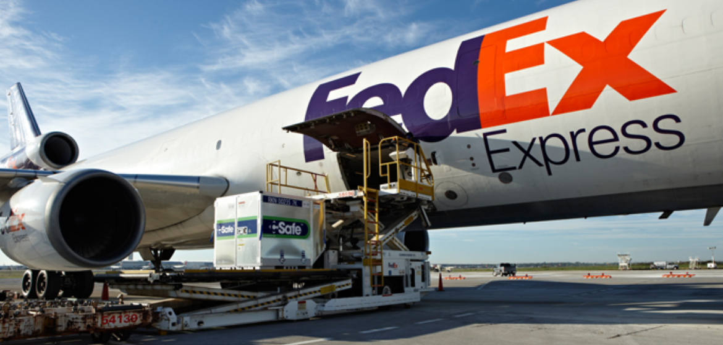
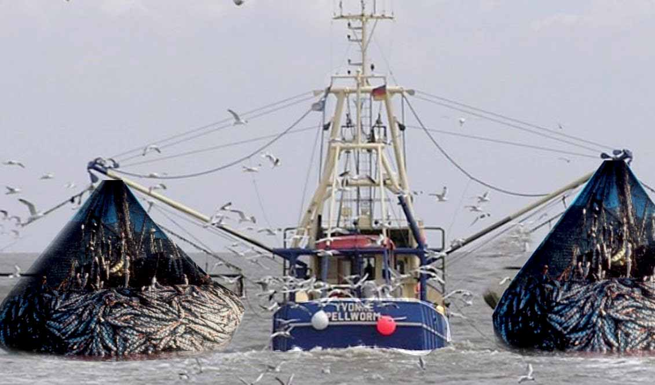
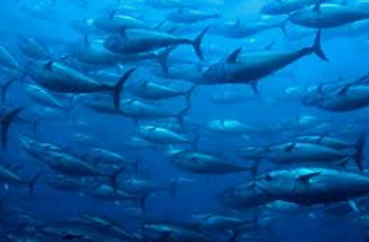
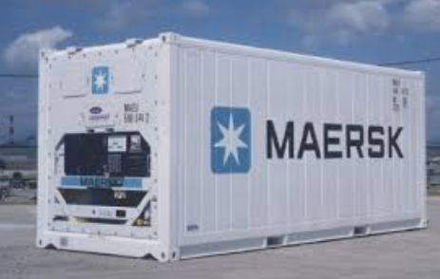
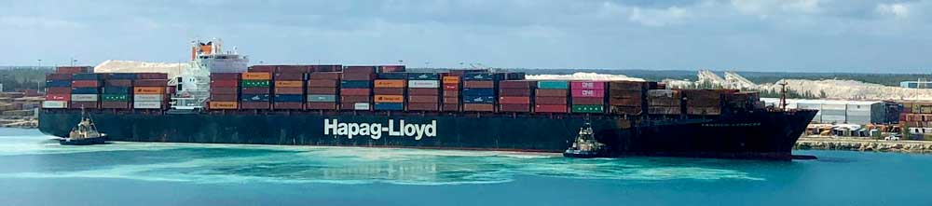


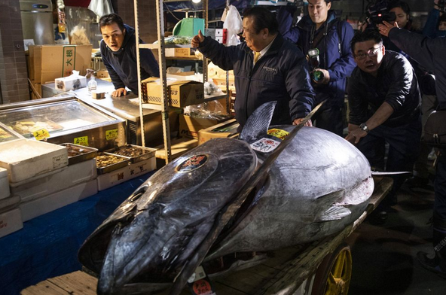
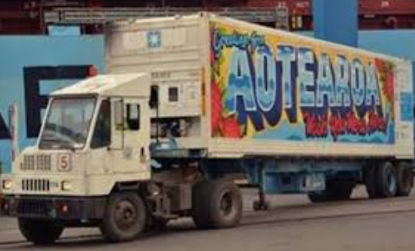
Excellent use case - Supply Chain
Notes:
Transparent Distributed Ledger
Hook to Fork
Tuna – prized can sell for millions of dollars!
Complex supply chain - Globalization – economy Japan – Usa –specialty – supermarket/delis -
Many touch points
Safety perishable!
Long travel distances – quick transport JAL / ICE / ref-containers / supercooled

Slide 18
IBM Food Trust - Walmart
Notes:
IBM Food Trust™ Walmart collaboration
uses blockchain technology to create unprecedented visibility and accountability in the food supply.
It’s the only network of its kind to connect growers, processors, distributors, and retailers through a permissioned, permanent and shared record of food system data.

Slide 19
Fabric - Technology Stack
Application – Auction –Supplychain – Finance - etc
SmartContracts
Go JavaScript Java ( Solidity )
CLI
Visual Studio Code + IBM BP Extension
Hyperledger Fabric Basic Network
IBM Blockchain Platform
Containers – Kubernetes and Docker
LAN / Internet / Cloud
Notes:
We are about to explore how to demo a blockchain app with visual studio code

Slide 20
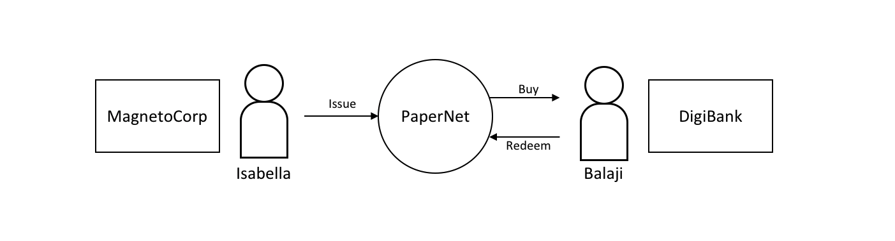

Slide 21
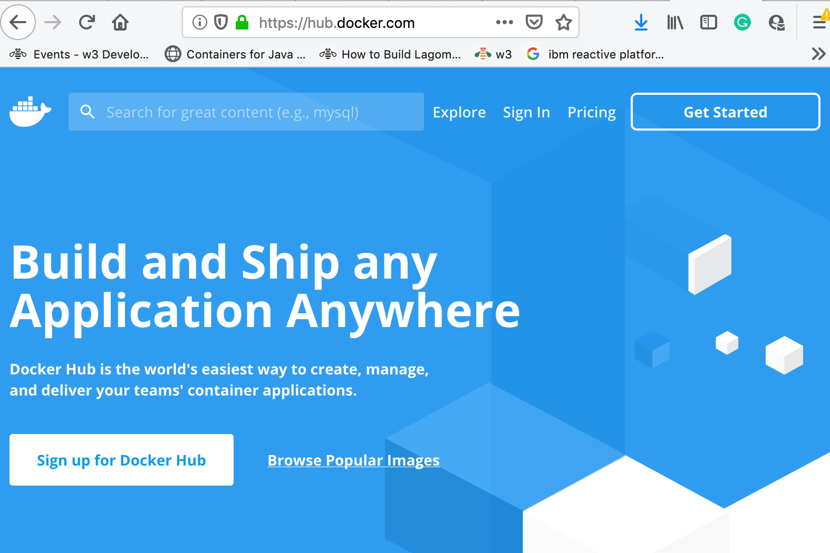
Hands On Workshop – prerequisites
Docker Hub Account – Get Started / Register or Sign In
Create an account or sign in
https://hub.docker.com/
Notes:
https://hub.docker.com/

Slide 22
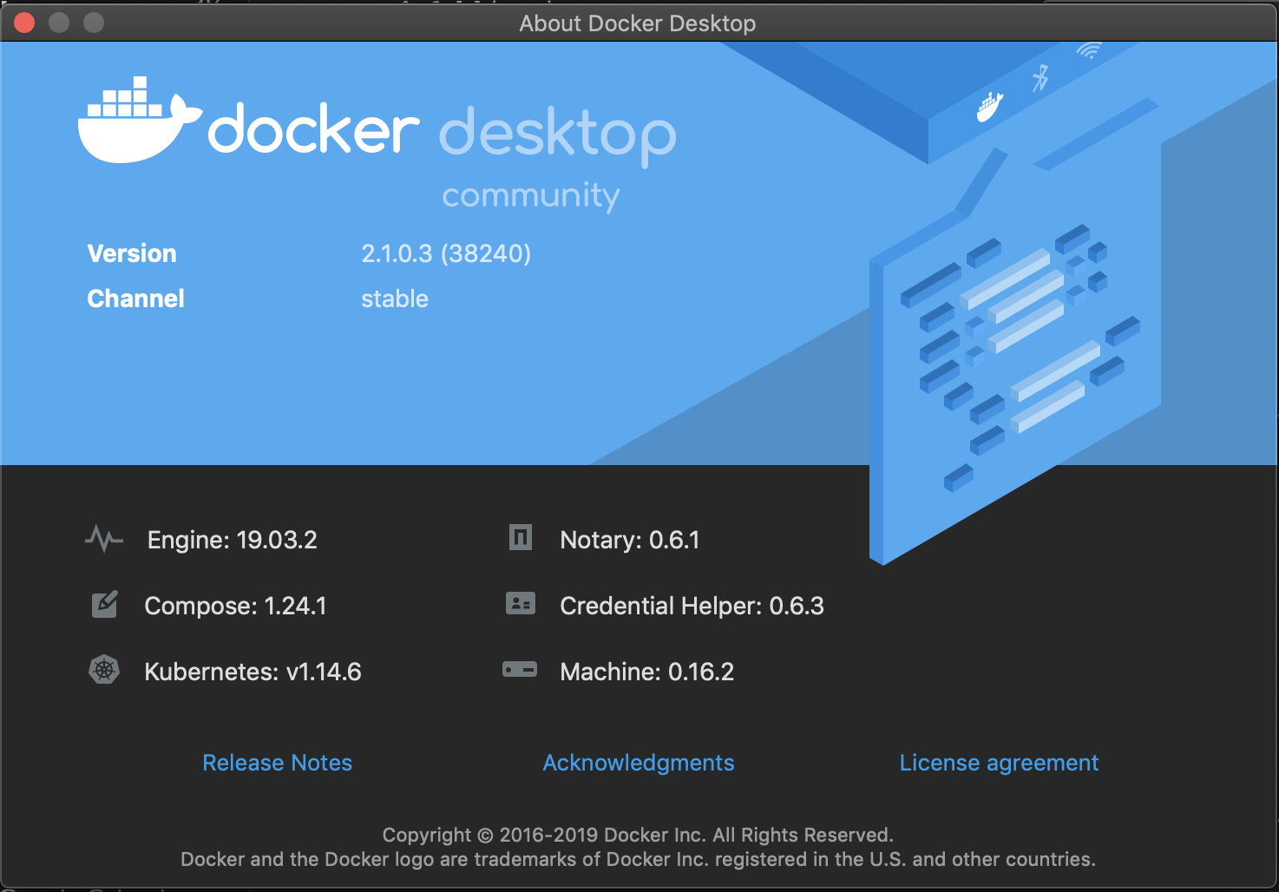
Hands On Workshop – prerequisites
Docker CE

Slide 23
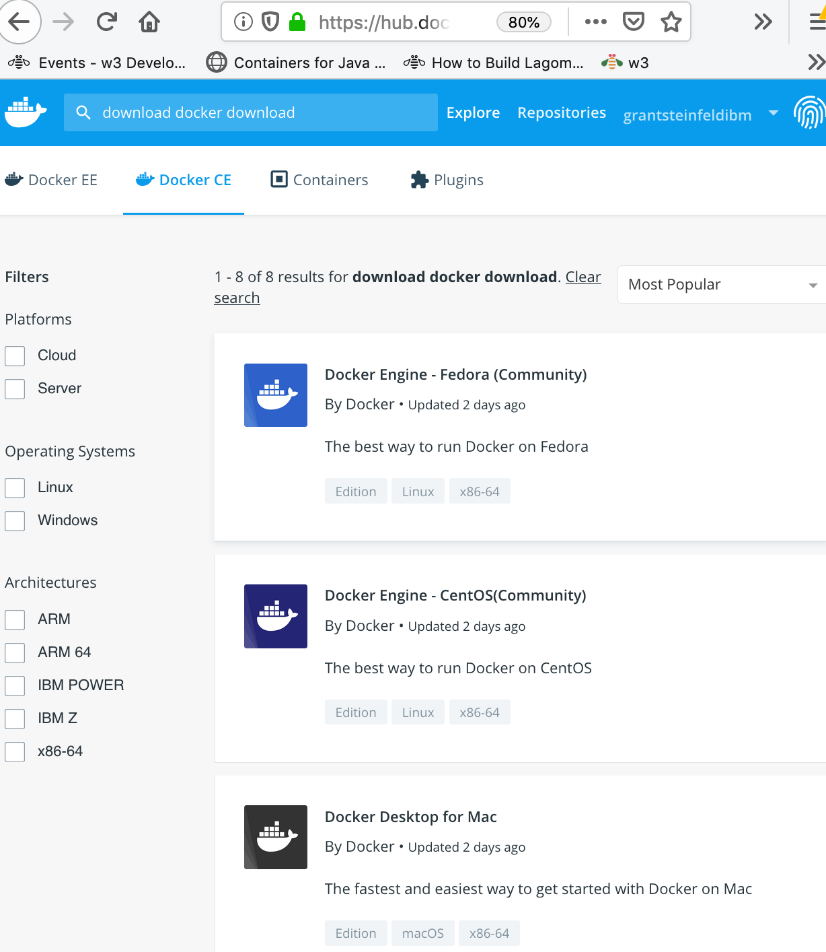
Hands On Workshop –
download
Docker CE
Notes:
Need a docker hub account to download!
Once installed on mac you shoud start docker.app and see it in your toolbar
Login via logging into to Icon on toolbar

Slide 24
Hands On Workshop –
download
docker-compose
you can use the usual commands to install or upgrade Compose:
curl -L https://github.com/docker/compose/releases/download/1.25.0-rc2/docker-compose-`uname -s`-`uname -m` -o /usr/local/bin/docker-compose chmod +x /usr/local/bin/docker-compose

Slide 25
Hands On Workshop – prerequisites
Docker CE

Slide 26
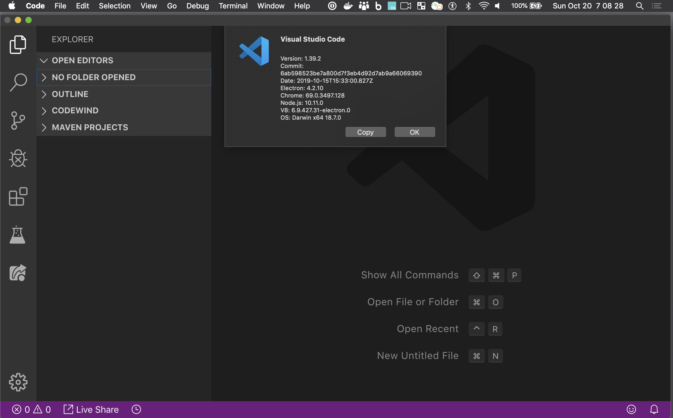
Hands On Workshop –
download
Visual Studio Code

Slide 27
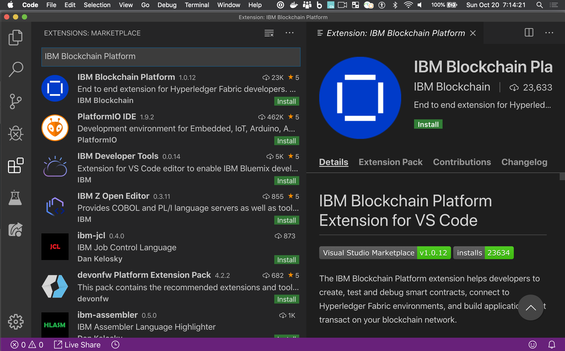
Hands On Workshop –
Install
IBM Blockchain Platform
Extension for Visual Studio Code
Notes:
May take a while depending on Bandwidth
The IBM Blockchain Platform extension helps developers to create, test and debug smart contracts, connect to Hyperledger Fabric environments, and build applications that transact on your blockchain network.

Slide 28
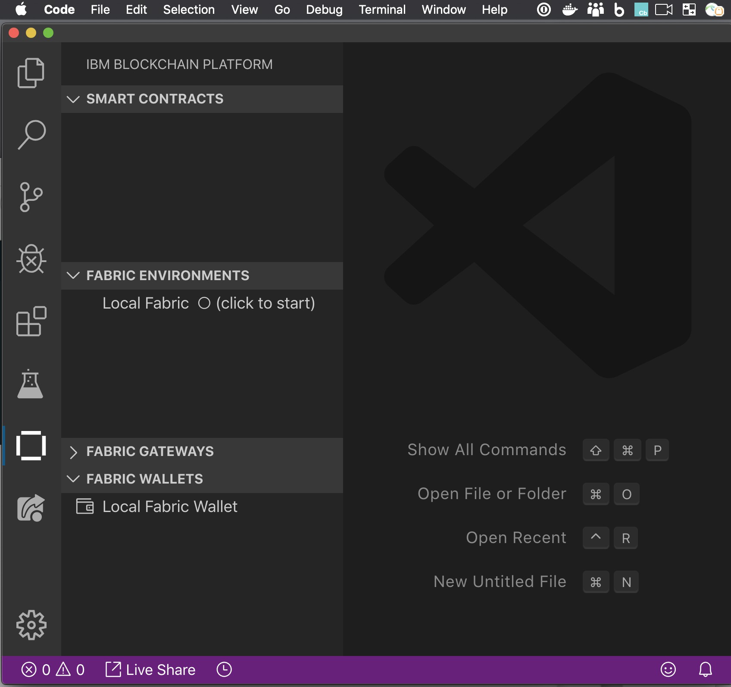
Hands On Workshop –
Success install
Of IBM Blockchain
Platform Extension
for VSCode

Slide 29
Codetime!!
Follow along with this tutorial
https://ibm.co/31wdrM3
Notes:
https://developer.ibm.com/tutorials/run-commercial-paper-smart-contract-with-ibm-blockchain-vscode-extension/
Estimated time
After the prerequisites are installed, this should take approximately 45 minutes to complete.

Slide 30
Codetime!!
Add a REST api Client!
https://bit.ly/2By6iQt
Notes:
Loopback4

Slide 31
Codetime!!
Add a Web Interface( time permitting)
https://ibm.co/31sJRHe
Notes:
https://developer.ibm.com/tutorials/queries-commercial-paper-smart-contract-ibm-blockchain-vscode-extension/

Slide 32
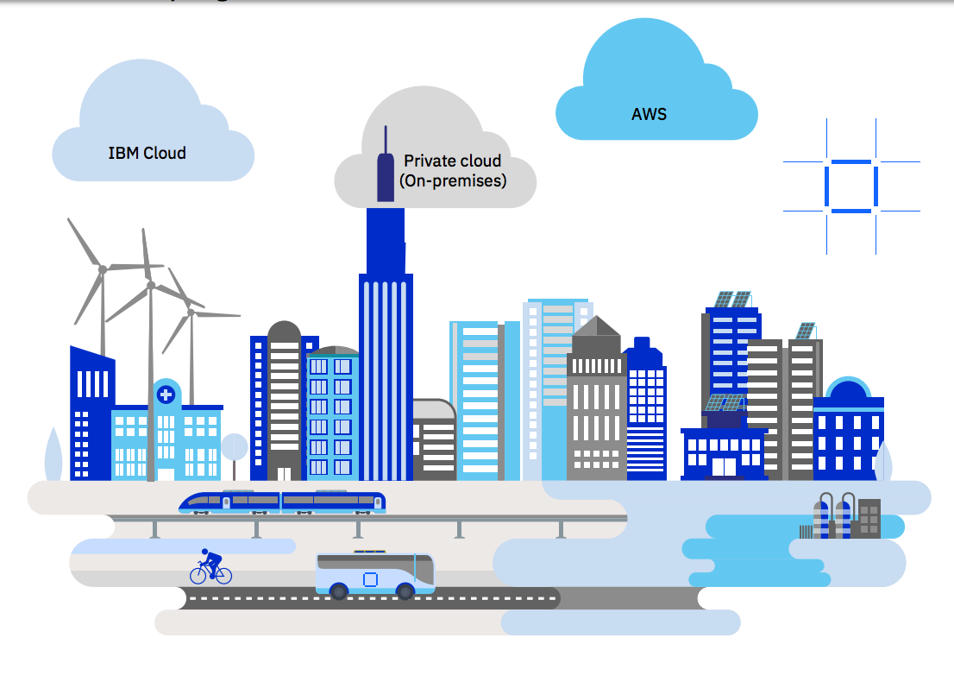
Deploy your Hyperledger Fabric project on IBM Blockchain – ANYWHERE!
Google
MS Azure
Oracle
SAP
Alibaba
IBM Cloud Private
Notes:
What next
You have Developed your first Hyperledger Fabric application How to get it into the cloud
Many options now
Just announce IBP anywhere!
A full-stack cloud platform that spans public, private and hybrid environments.
IBM cloud – reliabily – scalability – speed – IBM Garage / Consulting …
Build with a robust suite of advanced data and AI tools, and draw on deep industry expertise to help you on your journey to the cloud.
--------------------------
Hybrid Cloud on IBM Z

Slide 33
What we have learned
Fabric - Basics of Blockchain for Business/Enterprise
Single distributed LEDGER/DB
shared privately amongst TRUSTED communities
Fabric – IBM contribution to LINUX FOUNDATION – Hyperledger Projects
Technical Hyperledger Fabric FabCar hands on coding/demo using VISUAL STUDIO Code
with IBM Blockchain Platform Extension
Show how to run Fabric SmartContracts on Cloud Network
IBM Blockchain platform 2.0 (free beta)
Notes:
Distributed LedgeDevelop on a local laptop a prototype
Specifically Hyperledger Fabric and how it forms the foundation of IBM Blockchain Platforms
The adoption of blockchain will be a balancing act for an enterprise.
It will not only have to run, manage, and maintain its existing infrastructure but also
pave the way to this new computational model that promises to fundamentally change enterprises and even whole industries.

Slide 34
Q&A

Slide 35
Resources and further learnings
Commercial paper tutorial
IBM Devloper Tutorial part 1
https://developer.ibm.com/tutorials/run-commercial-paper-smart-contract-with-ibm-blockchain-vscode-extension/
(from HLF read the docs)
https://hyperledger-fabric.readthedocs.io/en/master/tutorial/commercial_paper.html
https://github.com/docker/compose/releases
Or
https://github.com/docker/compose/releases

Slide 36
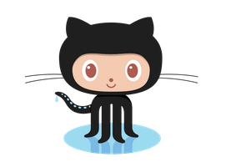
Continue this journey
What’s next?
Sign up for a free trial IBM Cloud account today to experience our new code-pattern IBM Blockchain Platform 2.0 ( Fabric v1.4)
https://cloud.ibm.com
This presentation, and other tips/issues-feedback please feel free to collaborate on this presentation on GitHub repo https://bit.ly/2J7DAN2
Notes:
Slides on github README.md
At

